Slide 1

How Customer Service
Drives Compliance
Learn about Localgov’s revenue-centric approach to support
Aquanetta White-Olive
Lead, Customer Service

Slide 2
Core Community Challenges
Why old-fashioned processes are hurting your bottom line
Municipalities are understaffed and tasked with more than ever.
Paper-based processes are a hassle and lead to errors.
Tracking down non-compliant filers is difficult, takes too much time.
Non-compliance leads to significant revenue losses.
Sound familiar? It’s time to consider a technology strategy designed specifically for local governments.

Slide 3
The Localgov Difference
Key benefits for municipalities
Taxpayers can file and pay when they want, how they want via our business-friendly and easy-to-use online platform.
Municipal employees can focus on more high-value services rather than pushing paper.
Finance leaders can count on more steady remittances and increased tax and fee compliance.
Increased satisfaction for all—employees, taxpayers, and finance leaders.

Slide 4
What is Concierge Customer Service?
How Localgov’s support team drives satisfaction & compliance
Our expertly trained team is led by a former business owner who understands taxpayers’ pain points.
We provide caring, one-on-one service based in compassion and confidence.
It’s our goal to make customers feel heard, respected, and helped as efficiently as possible.
We build real rapport with customers while increasing their knowledge about using Localgov.
No long hold times or chat bots. Instead, we offer live, one-on-one phone support.
And always—we’re upbeat, enthusiastic, and ready to pitch in!

Slide 5
Extra Assistance for Municipalities
Localgov does heavy lifting for local-government staff
We document all customer interactions for the utmost transparency.
Municipalities will receive Service Activity Reports at regular intervals.
Our team assists with managing municipal Business Master Listings.
We help ensure compliance by reaching out to delinquent accounts.
Localgov’s Concierge Customer Service cares for taxpayer’s issues and municipal needs. How can we help you today?

Slide 6
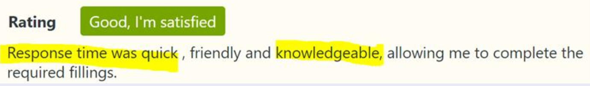
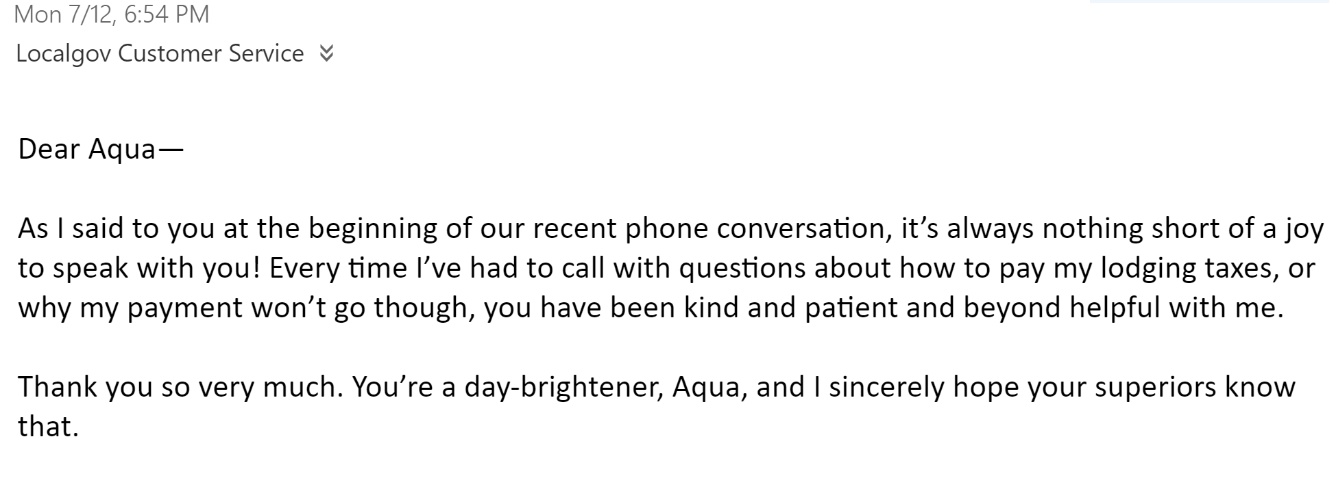
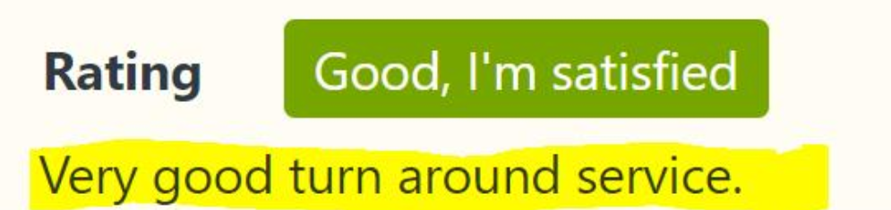
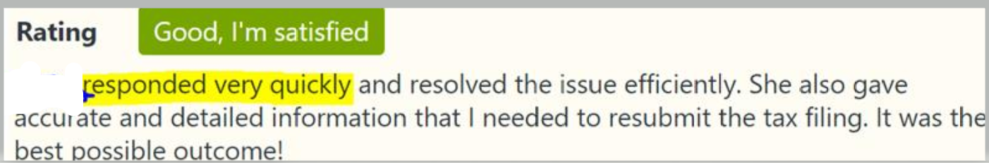
We Have the Ratings to Prove it!
The Localgov Customer Service team makes certain all needs are met, every issue is resolved, and our customer is completely satisfied.

